Slide 1

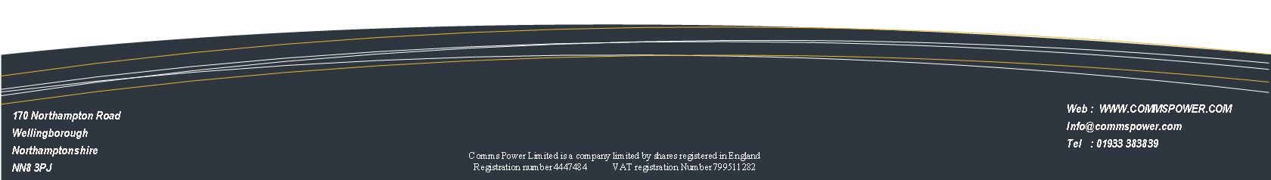
The provision of AC, DC & Telecommunications
Services & Solutions

Slide 2

Comms Power Limited is a company with over 40+ years experience in the areas of Critical power Installation & Maintenance and Telecommunications
We specialise in, AC and DC power installations & commissioning and M&E infrastructure installation and Telecommunications equipment
We are able to offer a full turnkey solution within Exchange and Data Centre environments
We have completed installations & projects across the UK, Europe and North Africa.
We are extremely experienced at working within mission critical areas where there can be no break in network uptime

Slide 3
Historically our staff have been in involved with and highly praised by companies which are all leaders in their own fields.
These include:
Verizon
SAFT Power LTD (Harmer & Simmons)
Everything-Everywhere (Orange/T-Mobile)
Nokia/Ericcson
Eircom
Vodafone
Ministry of Defence
British Telecom (BT)
Openreach
Eaton Power Solutions
Cable & Wireless
Synetrix
Huawei
Talk Talk
NTT EU
Virgin Media
Level 3 Communications
Telehouse

Slide 4
Key Competencies
Installation of DC and AC power distribution cabinets and frames
Vast experience of the BT LLU (Local Loop Unbundling) offering and LLU Operators equipment
Installation and Commissioning of AC & DC power systems
Installation, Commissioning, periodic testing and maintenance of Standby Power Batteries & Systems
Cable Containment and Infrastructure installations
AC and Inverted AC power system installations
Works within mission critical areas.
Exchange & Data Centre infrastructure (racks, power supplies, cable management and interconnectivity cabling)
The Installation and Commissioning of MSAN’s (Multi Service Access Nodes) and DSLAM’s (Digital Subscriber Line Access Multiplexers
Fixed line and Mobile Telecommunications equipment
Copper, Co-axial, Cat 5/6 and fibre installations

Slide 5
Key Skills
All electricians C&G 2361 & 17th edition BS7671 trained and time served
All electricians DC specialist & experienced
Factory trained installation courses where appropriate
Multi skilled teams telecoms / electrical / mechanical mixes where required
Mobile – UK wide operation
24 / 7 demonstrated capability
Telecoms infrastructure conversant and operations aware
In depth knowledge of Health & Safety working procedures and documentation
Skilled at Live working procedures and techniques (no network downtime)
Site audit and testing capable teams
Engineers skilled in the main power vendor equipment utilised today – AC & DC
Engineers skilled in the main telecoms equipment vendors systems and network practices
A backroom support team that has programme and project managed major network rollouts, on time and on budget (LLU main carriers and ISP’s)
Skilled power system technicians – live working & connection capable

Slide 6
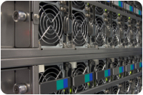
Energy Products/Services
AC LVD Distribution boards
DC Distribution Cabinets and boards
UPS systems
DC Systems & Rectifiers
Power Sub Distribution (AC & DC) Cabinets/Modules, Intelligent power strips
AC to DC Inverters
Racks and Enclosures
Batteries
Factory optimised pre build & pre staged modular solutions
Power Optimisation Equipment (Energy Efficiency)
Cabling & Cables
Consumables

Slide 7
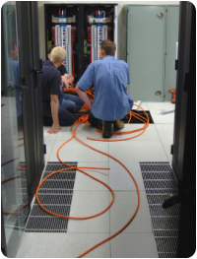
DC Systems
Experienced in the design and implementation / installation of AC & DC power schemes & Backup Battery systems
Experienced in all major OEM’s DC systems including
PowerOne
Eltek
Eaton Powerware
Benning
SAFT (Harmer & Simmons)
Delta
Lineage (GE Energy)
Emerson/Ericsson

Slide 8
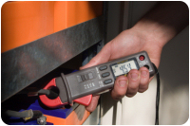
AC Services
AC upgrade & switchgear new build
AC Enablement works
UPS provision & Installation
Inverter provision & Installation
UPS in life maintenance
AC infrastructure design & Installation
Street cabinet installation
M&E Site recovery
Project Management
Supply authority liaison
Safety Appliance testing
24 / 7 capability

Slide 9
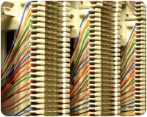
Telecom & Data Centre Services
Traditional Copper installation (i.e tie pairs / gun wrapping / block punching etc )
On site testing & commissioning
MSAN & DSLAM Installation and Commissioning
TAMS
Structured cabling installation
Installation of cable management systems- Fibre management, Basket mesh, Power management & trunking, Steel trays (under floor & overhead)
DC Power System installation
UPS installation & AC Enablement
Internal and external fibre and copper connectivity
Cat 5e & Cat 6 solutions
Project Management
Card infill’s and Expansion
Interconnectivity cabling
LLU environment and installation

Slide 10
Coverage and Capacity
UK wide coverage from Northampton and strategically based project management and engineers
Capable of multisite and multi team operations
24 / 7 flexible and capable
Dedicated program and project managing resource
Dedicated job quality auditing resource

Slide 11
Key Contacts
Paul Farr – paul@commspower.com
Tel: 07595495963
Jon Ekins – jonekins@commspower.com
Tel: 07764754361
Steve Brown – steve@commspower.com
Tel: 07521715575
Web: www.commspower.com
Registered Office: 170 Northampton Road
Wellingborough
Northants
NN8 3PJ

